Slide 1

MORS Emerging Techniques Introduction to Tidymodels
MAJ Dusty Turner | Max Kuhn
Distribution Statement: This presentation is unclassified, approved for public release, distribution unlimited, and is exempt from U.S. export licensing and other export approvals under the International Traffic in Arms Regulations (22 CFR 120 et seq.)
Disclaimer: Reference herein to any specific commercial products, process, or service by trade name, trademark, manufacturer, or otherwise, does not necessarily constitute or imply its endorsement, recommendation, or favoring by the United States Government.
MAJ Dusty Turner
dusty.s.turner.mil@mail.mil

Slide 2
Who am I?
Army
Combat Engineer
Platoon Leader / XO / Company Commander
Geospatial / Sapper / Route Clearance
Hawaii / White Sands Missile Range / Iraq / Afghanistan
Education
West Point ’07
Operations Research, BS
Missouri University of Science and Technology ’12
Engineering Management, MS
THE Ohio State ’16
Integrated Systems Engineering, MS
Applied Statistics, Graduate Minor
Data Science
R User Since ’14
Catch me on Twitter @dtdusty
http://dusty-turner.netlify.com/

Slide 3
What am I assuming about you?
Data Science Background
Moderate R Background
Pretty much a super nerd
www.tenor.com

Slide 4

What are we going to talk about?
Let's talk about
…modeling in R the old way (caret)
…modeling in R the (very) new way (tidymodels)
…an example (Flying Hour Challenge)

Slide 5
Out with the old caret –> In with the new tidymodels
caret:
Classification And REgression Training
Released in 2008
Functionality
Impute missing data
Split test/train/validate set
Supports a multitude of modeling techniques
Supports cross validation
Supports model performance measurements
Drawbacks
Clunky syntax
Requires unique syntax for each function
tidymodels
Released in October 2019
Functionality
Same as caret
‘tidy’ compatible
Streamlined Syntax
Drawbacks
Not fully built out yet

Slide 6
More details of tidymodels
From the documentation:
“tidymodels is a “meta-package” for modeling and statistical analysis that share the underlying design philosophy, grammar, and data structures of the tidyverse.”
Imports the following packages:
broom: takes messy output and makes them ‘tidy’ compatible
infer: modern approach to statistical inference
recipes: general data processor with a modern interface that incorporates feature engineering, imputation, and other help tools
yardstick: contains tools for evaluating models (e.g., accuracy and RMSE)
tidypredict: translates some model prediction equations to SQL for high-performance computing
tidyposterior: used to compare models using resampling and Bayesian analysis
tidytext: contains ‘tidy’ tools for quantitative text analysis
https://github.com/tidymodels/tidymodels
install.packages("tidymodels")

Slide 7

More details of tidymodels
Author is Max Kuhn of RStudio @topepo
Kuhn, M., & Johnson, K. (2013). Applied predictive modeling. New York: Springer.

Slide 8
Where does this fit in the modeling process?

Slide 9
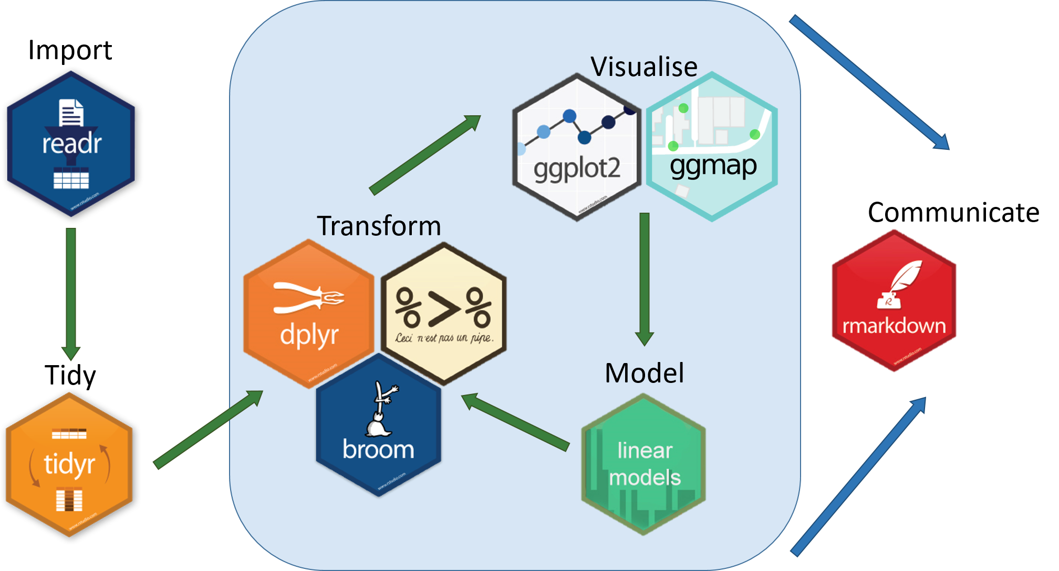
tidyverse Schema
https://www.tidyverse.org/

Slide 10

tidymodels Schema
https://www.tidyverse.org/

Slide 11
What We’re Going to Do:
Introduce a Data Problem: Flying Hour Challenge
Show the old techniques: caret
Show the new technique: tidymodels
Discuss Challenges
Main Libraries
library(caret) library(tidyverse) library(tidymodels)

Slide 12
Flying Hour Challenge - Inspect the Data
hours_flown | as_of_date | mc_percent | poss_hrs | fmc_percent | age_years_by_accept_date
9 | 10/15/2011 | 1.00000 | 720 | 1.00000 | 25.7616438
14 | 10/15/2011 | 1.00000 | 720 | 1.00000 | 25.7616438
19 | 10/15/2011 | 0.97500 | 720 | 0.97500 | 25.7616438
20 | 10/15/2011 | 1.00000 | 720 | 1.00000 | 25.4328767
6 | 10/15/2011 | 1.00000 | 720 | 1.00000 | 27.4328767
13 | 10/15/2011 | 0.85000 | 720 | 0.85000 | 24.5150685
3 | 10/15/2011 | 0.51250 | 720 | 0.51250 | 24.3479452
143 | 10/15/2011 | 0.91250 | 720 | 0.91250 | 6.4191781
30 | 10/15/2011 | 0.91528 | 720 | 0.91528 | 0.8301370
47 | 10/15/2011 | 1.00000 | 720 | 1.00000 | 0.9123288

Slide 13
skimr Numeric Variables
variable | missing | n | mean | sd | p0 | p50 | p100 | hist
fy | 0 | 74849 | 2013.98 | 1.41 | 2012.00 | 2014.00 | 2016.00 | ▇▇▁▇▁▇▁▇
fiscal_month | 0 | 74849 | 6.53 | 3.45 | 1.00 | 7.00 | 12.00 | ▇▃▇▃▃▇▅▇
age_years_by_accept_date | 64 | 74849 | 10.65 | 8.95 | -4.26 | 7.33 | 35.90 | ▁▇▅▂▃▂▂▁
qty_reported_for_readiness | 0 | 74849 | 0.94 | 0.24 | 0.00 | 1.00 | 1.00 | ▁▁▁▁▇
poss_hrs | 0 | 74849 | 683.26 | 181.20 | 0.00 | 744.00 | 744.00 | ▁▁▁▁▇
mc_hrs | 0 | 74849 | 529.85 | 255.99 | 0.00 | 655.00 | 744.00 | ▂▁▁▁▁▁▂▇
mc_percent | 4872 | 74849 | 0.78 | 0.30 | 0.00 | 0.92 | 1.00 | ▁▁▁▁▂▇
da_2_year_mc_hist_avg | 0 | 74849 | 0.73 | 0.04 | 0.67 | 0.71 | 0.81 | ▁▁▇▁▁▁▂▁
avail_hours_days | 0 | 74849 | 484.35 | 271.25 | 0.00 | 608.00 | 744.00 | ▃▁▁▁▁▂▃▇
fmc_percent | 4872 | 74849 | 0.71 | 0.34 | 0.00 | 0.86 | 1.00 | ▂▁▁▁▁▂▂▇
da_2_year_fmc_hist_avg | 0 | 74849 | 0.66 | 0.05 | 0.54 | 0.64 | 0.75 | ▂▁▁▇▃▂▂▃
nmcs_days_hrs | 0 | 74849 | 16.92 | 76.10 | 0.00 | 0.00 | 744.00 | ▇▁▁▁▁▁▁▁
nmcs_percent | 4872 | 74849 | 0.02 | 0.11 | 0.00 | 0.00 | 1.00 | ▇▁▁▁▁▁▁▁
da_2_year_nmcs_hist_avg | 0 | 74849 | 0.05 | 0.01 | 0.03 | 0.05 | 0.07 | ▃▃▁▇▁▁▁▅
nmcm_days_hrs | 0 | 74849 | 136.49 | 204.75 | 0.00 | 40.00 | 744.00 | ▇▂▁▁▁▁▁▁

Slide 14
skimr Character
variable | missing | complete | n | min | max | empty | n_unique
as_of_date | 0 | 74849 | 74849 | 9 | 10 | 0 | 60
mth | 0 | 74849 | 74849 | 3 | 3 | 0 | 12
The Data is a Mess

Slide 15
Flying Hour Challenge - Data Processing
ensure correct data type
mutate(as_of_date = lubridate::mdy(as_of_date))
remove near zero variance
nearZeroVar()
linear dependencies
findLinearCombos()
handle NAs (next slide)

Slide 16
Handle NAs
name | NotMissing | Missing
fmc_percent | 69977 | 4872
mc_percent | 69977 | 4872
nmcm_depot_percent | 69977 | 4872
nmcm_percent | 69977 | 4872
nmcm_spt_percent | 69977 | 4872
nmcs_percent | 69977 | 4872
pmc_percent | 69977 | 4872
pmcm_percent | 69977 | 4872
pmcs_percent | 69977 | 4872
age_years_by_accept_date | 74785 | 64
as_of_date | 74849 | NA
avail_hours_days | 74849 | NA

Slide 17
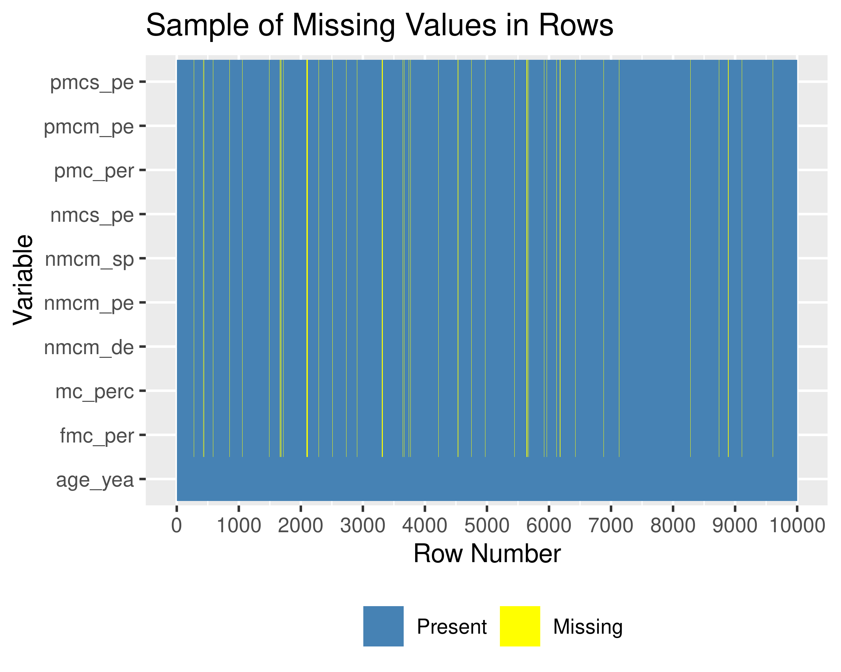
Plot View
Many columns have missing data and data is not missing at random

Slide 18

The Old: CARET

Slide 19
caret: Preprocess
preprocessvalues = preProcess(rawdata[,-33], method = c("medianImpute","nzv", "center", "scale"))
caretimpute = predict(preprocessvalues, rawdata)

Slide 20
caret: Split in Train/Testing
trainIndex = createDataPartition(caretimpute$hours_flown, p = .7)
dataTrain = caretimpute[trainIndex$Resample1,]
dataTest = caretimpute[-trainIndex$Resample1,]

Slide 21
caret: Build Models
caretlm = train(hours_flown ~ ., data = dataTrain, method = "lm", trControl = trainControl(method = "none")) caretrf = train(hours_flown ~ ., data = sample_n(dataTrain,5000), method = "rf", trControl = trainControl(method = "none")) # caretranger = train(hours_flown ~ ., data = dataTrain, # method = "ranger", # trControl = trainControl(method = "none")) caretglm = train(hours_flown ~ ., data = dataTrain, method = "glmnet", trControl = trainControl(method = "none"))

Slide 22
caret: Predict and Evaluate
Predict
lm.pred = predict(caretlm, dataTest) rf.pred = predict(caretrf, dataTest) glm.pred = predict(caretglm, dataTest)
Evaluate Models
Model | RMSE | Rsquared | MAE
RF | 0.4549430 | 0.8098941 | 0.2712814
LM | 0.5050112 | 0.7469176 | 0.3090749
GLM | 0.5059139 | 0.7464147 | 0.3062023
RMSE: Root Mean Squared Error
Rsquared: R Squared
MAE: Mean Absolute Error

Slide 23

The New: tidymodels

Slide 24
tidymodels: Split
data_split = rawdata %>% initial_split(prop = .7) data_split
## <52395/22454/74849>

Slide 25
tidymodels: Preprocess
flight_recipe =
data_split %>%
training() %>%
recipe(hours_flown ~ .) %>%
step_meanimpute(all_numeric(), -all_outcomes()) %>%
step_corr(all_numeric(), -all_outcomes()) %>% step_center(all_numeric(), -all_outcomes()) %>%
step_scale(all_numeric(), -all_outcomes()) %>%
prep()

Slide 26
tidymodels: Preprocess
flight_recipe =
data_split %>%
training() %>%
recipe(hours_flown ~ .) %>%
step_meanimpute(all_numeric(), -all_outcomes()) %>%
step_corr(all_numeric(), -all_outcomes()) %>% step_center(all_numeric(), -all_outcomes()) %>%
step_scale(all_numeric(), -all_outcomes()) %>%
prep()

Slide 27
tidymodels: Preprocess
flight_recipe =
data_split %>%
training() %>%
recipe(hours_flown ~ .) %>%
step_meanimpute(all_numeric(), -all_outcomes()) %>%
step_corr(all_numeric(), -all_outcomes()) %>% step_center(all_numeric(), -all_outcomes()) %>%
step_scale(all_numeric(), -all_outcomes()) %>%
prep()

Slide 28
tidymodels: Preprocess
flight_recipe =
data_split %>%
training() %>%
recipe(hours_flown ~ .) %>%
step_meanimpute(all_numeric(), -all_outcomes()) %>%
step_corr(all_numeric(), -all_outcomes()) %>% step_center(all_numeric(), -all_outcomes()) %>%
step_scale(all_numeric(), -all_outcomes()) %>%
prep()

Slide 29
tidymodels: Preprocess
flight_recipe =
data_split %>%
training() %>%
recipe(hours_flown ~ .) %>%
step_meanimpute(all_numeric(), -all_outcomes()) %>%
step_corr(all_numeric(), -all_outcomes()) %>% step_center(all_numeric(), -all_outcomes()) %>%
step_scale(all_numeric(), -all_outcomes()) %>%
prep()

Slide 30
tidymodels: Preprocess
flight_recipe
## Data Recipe ## ## Inputs: ## ## role #variables ## outcome 1 ## predictor 33 ## ## Training data contained 52395 data points and 3426 incomplete rows. ## ## Operations: ## ## Mean Imputation for fy, fiscal_month, ... [trained] ## Correlation filter removed poss_hrs, nmcs_days_hrs, ... [trained] ## Centering for fy, fiscal_month, ... [trained] ## Scaling for fy, fiscal_month, ... [trained]

Slide 31
tidymodels: Prepare Training and Testing Data
juice Training Data
flight_training = juice(flight_recipe)
bake Testing Data
flight_testing = flight_recipe %>% bake(testing(data_split))

Slide 32
tidymodels: Build Models
flight_lm = linear_reg(mode = "regression") %>% set_engine("lm") %>% fit(hours_flown ~ ., data = flight_training) flight_rf = rand_forest(trees = 10, mode = "regression") %>% set_engine("randomForest") %>% fit(hours_flown ~ ., data = flight_training) flight_ranger = rand_forest(trees = 50, mode = "regression") %>% set_engine("ranger") %>% fit(hours_flown ~ ., data = flight_training) flight_glm = linear_reg(mode = "regression") %>% set_engine("glmnet") %>% fit(hours_flown ~ ., data = flight_training)

Slide 33
tidymodels: Build Models
flight_lm = linear_reg(mode = "regression") %>% set_engine("lm") %>% fit(hours_flown ~ ., data = flight_training) flight_rf = rand_forest(trees = 10, mode = "regression") %>% set_engine("randomForest") %>% fit(hours_flown ~ ., data = flight_training) flight_ranger = rand_forest(trees = 50, mode = "regression") %>% set_engine("ranger") %>% fit(hours_flown ~ ., data = flight_training) flight_glm = linear_reg(mode = "regression") %>% set_engine("glmnet") %>% fit(hours_flown ~ ., data = flight_training)

Slide 34
tidymodels: Build Models
flight_lm = linear_reg(mode = "regression") %>% set_engine("lm") %>% fit(hours_flown ~ ., data = flight_training) flight_rf = rand_forest(trees = 10, mode = "regression") %>% set_engine("randomForest") %>% fit(hours_flown ~ ., data = flight_training) flight_ranger = rand_forest(trees = 50, mode = "regression") %>% set_engine("ranger") %>% fit(hours_flown ~ ., data = flight_training) flight_glm = linear_reg(mode = "regression") %>% set_engine("glmnet") %>% fit(hours_flown ~ ., data = flight_training)

Slide 35
tidymodels: Build Models
flight_lm = linear_reg(mode = "regression") %>% set_engine("lm") %>% fit(hours_flown ~ ., data = flight_training) flight_rf = rand_forest(trees = 10, mode = "regression") %>% set_engine("randomForest") %>% fit(hours_flown ~ ., data = flight_training) flight_ranger = rand_forest(trees = 50, mode = "regression") %>% set_engine("ranger") %>% fit(hours_flown ~ ., data = flight_training) flight_glm = linear_reg(mode = "regression") %>% set_engine("glmnet") %>% fit(hours_flown ~ ., data = flight_training)

Slide 36
tidymodels: Side Note
Models Currently Available
lm
tree-based
survival analysis
bayesian

Slide 37
tidymodels: Predict and Evaluate
flight_testing %>% select(hours_flown) %>% bind_cols( predict(flight_lm, flight_testing) %>% rename(lm_pred = .pred), predict(flight_rf, flight_testing) %>% rename(rf_pred = .pred), predict(flight_ranger, flight_testing) %>% rename(ranger_pred = .pred), predict(flight_glm, flight_testing, penalty = 10) %>% rename(lasso_glm = .pred), ) %>% pivot_longer(cols = -hours_flown) %>% rename(model = name, prediction = value) %>% group_by(model) %>% metrics(truth = hours_flown, estimate = prediction) %>% select(-.estimator) %>% pivot_wider(names_from = .metric, values_from = .estimate) %>% arrange(rmse)
model | RMSE | R^2 | MAE
ranger_pred | 9.66 | .845 | 5.67
rf_pred | 9.73 | .838 | 5.45
lm_pred | 12.3 | .742 | 7.47
lasso_glm | 16.8 | .694 | 10.9
RMSE: Root Mean Squared Error
R^2: R Squared
MAE: Mean Absolute Error

Slide 38
tidymodels: Predict and Evaluate
flight_testing %>% select(hours_flown) %>% bind_cols( predict(flight_lm, flight_testing) %>% rename(lm_pred = .pred), predict(flight_rf, flight_testing) %>% rename(rf_pred = .pred), predict(flight_ranger, flight_testing) %>% rename(ranger_pred = .pred), predict(flight_glm, flight_testing, penalty = 10) %>% rename(lasso_glm = .pred), ) %>% pivot_longer(cols = -hours_flown) %>% rename(model = name, prediction = value) %>% group_by(model) %>% metrics(truth = hours_flown, estimate = prediction) %>% select(-.estimator) %>% pivot_wider(names_from = .metric, values_from = .estimate) %>% arrange(rmse)
model | RMSE | R^2 | MAE
ranger_pred | 9.66 | .845 | 5.67
rf_pred | 9.73 | .838 | 5.45
lm_pred | 12.3 | .742 | 7.47
lasso_glm | 16.8 | .694 | 10.9
RMSE: Root Mean Squared Error
R^2: R Squared
MAE: Mean Absolute Error

Slide 39
tidymodels: Predict and Evaluate
flight_testing %>% select(hours_flown) %>% bind_cols( predict(flight_lm, flight_testing) %>% rename(lm_pred = .pred), predict(flight_rf, flight_testing) %>% rename(rf_pred = .pred), predict(flight_ranger, flight_testing) %>% rename(ranger_pred = .pred), predict(flight_glm, flight_testing, penalty = 10) %>% rename(lasso_glm = .pred), ) %>% pivot_longer(cols = -hours_flown) %>% rename(model = name, prediction = value) %>% group_by(model) %>% metrics(truth = hours_flown, estimate = prediction) %>% select(-.estimator) %>% pivot_wider(names_from = .metric, values_from = .estimate) %>% arrange(rmse)
model | RMSE | R^2 | MAE
ranger_pred | 9.66 | .845 | 5.67
rf_pred | 9.73 | .838 | 5.45
lm_pred | 12.3 | .742 | 7.47
lasso_glm | 16.8 | .694 | 10.9
RMSE: Root Mean Squared Error
R^2: R Squared
MAE: Mean Absolute Error

Slide 40
tidymodels: Predict and Evaluate
flight_testing %>% select(hours_flown) %>% bind_cols( predict(flight_lm, flight_testing) %>% rename(lm_pred = .pred), predict(flight_rf, flight_testing) %>% rename(rf_pred = .pred), predict(flight_ranger, flight_testing) %>% rename(ranger_pred = .pred), predict(flight_glm, flight_testing, penalty = 10) %>% rename(lasso_glm = .pred), ) %>% pivot_longer(cols = -hours_flown) %>% rename(model = name, prediction = value) %>% group_by(model) %>% metrics(truth = hours_flown, estimate = prediction) %>% select(-.estimator) %>% pivot_wider(names_from = .metric, values_from = .estimate) %>% arrange(rmse)
model | RMSE | R^2 | MAE
ranger_pred | 9.66 | .845 | 5.67
rf_pred | 9.73 | .838 | 5.45
lm_pred | 12.3 | .742 | 7.47
lasso_glm | 16.8 | .694 | 10.9
RMSE: Root Mean Squared Error
R^2: R Squared
MAE: Mean Absolute Error

Slide 41
tidymodels: Predict and Evaluate
flight_testing %>% select(hours_flown) %>% bind_cols( predict(flight_lm, flight_testing) %>% rename(lm_pred = .pred), predict(flight_rf, flight_testing) %>% rename(rf_pred = .pred), predict(flight_ranger, flight_testing) %>% rename(ranger_pred = .pred), predict(flight_glm, flight_testing, penalty = 10) %>% rename(lasso_glm = .pred), ) %>% pivot_longer(cols = -hours_flown) %>% rename(model = name, prediction = value) %>% group_by(model) %>% metrics(truth = hours_flown, estimate = prediction) %>% select(-.estimator) %>% pivot_wider(names_from = .metric, values_from = .estimate) %>% arrange(rmse)
model | RMSE | R^2 | MAE
ranger_pred | 9.66 | .845 | 5.67
rf_pred | 9.73 | .838 | 5.45
lm_pred | 12.3 | .742 | 7.47
lasso_glm | 16.8 | .694 | 10.9
RMSE: Root Mean Squared Error
R^2: R Squared
MAE: Mean Absolute Error

Slide 42
tidymodels: The Next Frontier
Further incorporation of model metrics (cross validation)
cross_data = vfold_cv(flight_training, v = 10) cross_data
## # 10-fold cross-validation ## # A tibble: 10 x 2 ## splits id ## <named list> <chr> ## 1 <split [47.2K/5.2K]> Fold01 ## 2 <split [47.2K/5.2K]> Fold02 ## 3 <split [47.2K/5.2K]> Fold03 ## 4 <split [47.2K/5.2K]> Fold04 ## 5 <split [47.2K/5.2K]> Fold05 ## 6 <split [47.2K/5.2K]> Fold06 ## 7 <split [47.2K/5.2K]> Fold07 ## 8 <split [47.2K/5.2K]> Fold08 ## 9 <split [47.2K/5.2K]> Fold09 ## 10 <split [47.2K/5.2K]> Fold10
Not quite there yet

Slide 43
Summary
caret
65,800 hits on Google Scholar
Proven to be successful
Clunky syntax
Being phased out
tidymodels
122 hits on Google Scholar (more by the day)
Streamlined ‘tidy’ syntax
Still in development
Backing of R Studio
Bottom line: With a streamlined syntax, the backing of R Studio, and many talented developers, tidymodels is the present and future of modeling in R.

Slide 44

Thanks!
MAJ Dusty Turner
Twitter: @dtdusty
Email: dusty.s.turner.mil@mail.mil
Github: dusty-turner
Personal Website:
https://dusty-turner.netlify.com/
Max Kuhn
Twitter: @topepo
Github: topepo
Contact me!
Download Presentation

